Slide 1
Rhythm Disturbances on the Preoperative Electrocardiogram
- Ch 31
Miller 2020

Slide 2
common during the perioperative period
Supravent/vent arrhythmias →⬆︎ perioperative risk
arrhythmias themselves
cardiopulmonary disease
postponement of elective surgery:
Uncontrolled AF (symptoms/hemodynamic compromise)
high-risk ventricular tachyarrhythmias
Rapid AF (>100/min)
symptomatic bradycardia
high-grade heart block (third-degree heart block)

Slide 3
First-degree AV block:
PR interval > 0.20 ms (HR= 50-100/min)
benign

Slide 4
Second-degree heart block:
PR interval > 0.20 ms + some blocked atrial beats
Mobitz type I block (Wenckebach block):
progressive lengthening of the PR interval til drop
more benign block
related to AV nodal delay
easily responsive to atropine
unlikely to progress to complete heart block

Slide 5
Mobitz type II block:
fixed and prolonged PR interval - no change before the drop
related to an infranodal block
capable of progressing to complete heart block
pacemaker (unless reversible causes: ischemia, drugs)

Slide 6
Third-degree AV block/complete heart block:
complete dissociation between the atrial and ventricular beats
pacemaker placement (unless a reversible source!)

Slide 7
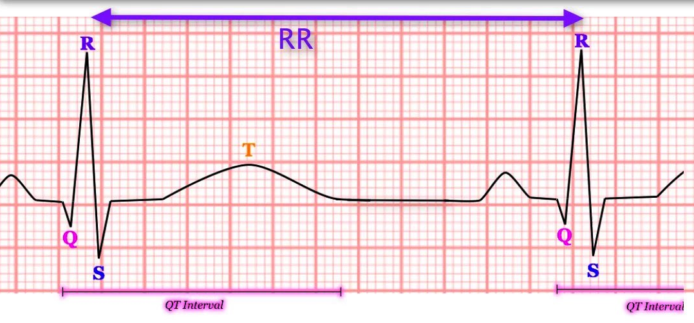
Prolonged QT interval:
evaluation of electrolytes (magnesium/calcium)
potentiating drugs
Syncope, presyncope, family history of sudden death→ cardiology consultation

Slide 8
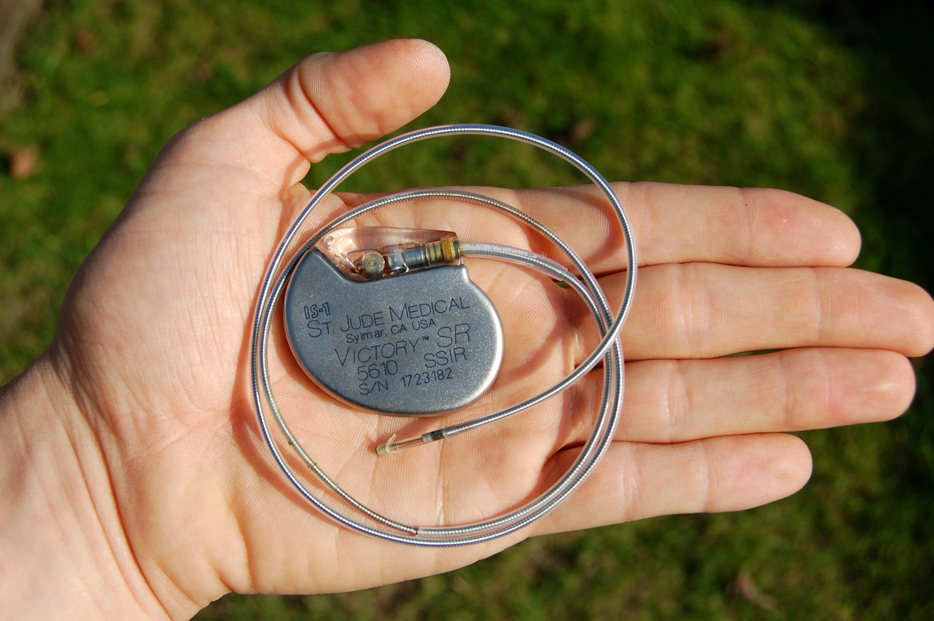
need for permanent pacemaker:
symptoms
location of conduction abnormality
reversible cause

Slide 9
Indications for perioperative pacemaker placement:
Class I Indications: definitely beneficial, useful, and effective
Sinus bradycardia + symptoms (HR < 40 bpm/frequent sinus pauses)
Symptomatic chronotropic incompetence (impaired HR response to exercise)
Third-degree AV block
Advanced second-degree AV block (≥ 2 consecutive P waves)
Symptomatic Mobitz I/II second-degree AV block
Mobitz II second-degree AV block + widened QRS/ chronic bifascicular block, regardless of symptoms
Exercise-induced second/third-degree AV block

Slide 10
Indications for perioperative pacemaker placement:
Class II Indications: Permanent pacing may be indicated but there is conflicting evidence and/or divergence of opinion
Sinus bradycardia (heart rate < 40 bpm) + symptoms
Sinus node dysfunction + history of unexplained syncope
Chronic HR < 40 bpm in an awake in minimally symptomatic patient
Asymptomatic Mobitz II second-degree AV block + narrow QRS interval
Bifascicular/trifascicular block + syncope
First-degree AV block + very long PR interval → AV dissociation/hemodynamic compromise

Slide 11
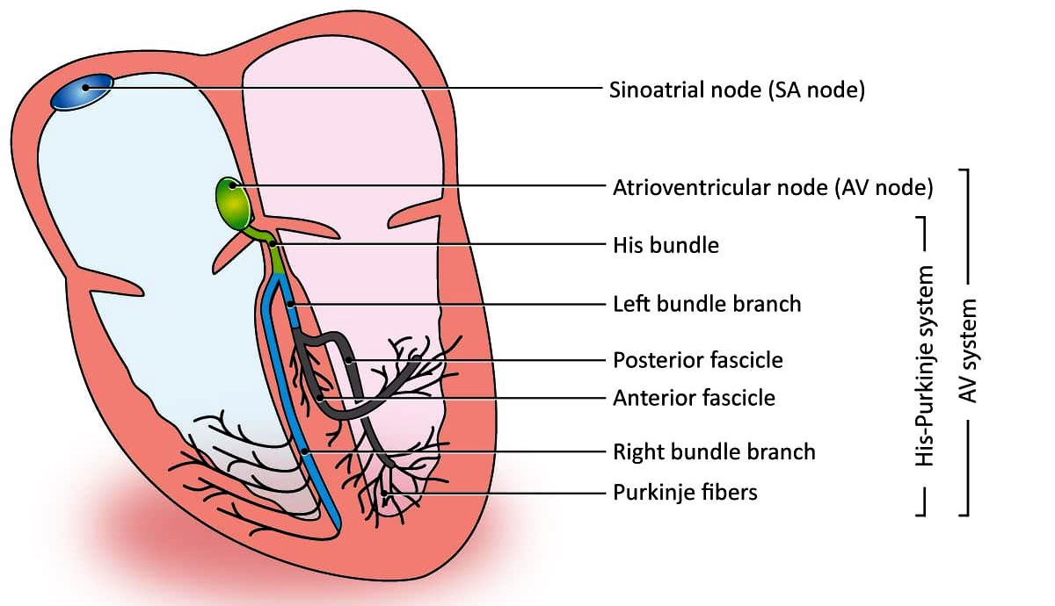
In general, pacemaker placement is required for symptomatic bradycardia/conduction delays that lead to syncope or presyncope.
Conduction disease below the AV node → less stable → likely benefits from permanent pacemaker placement:
normal or minimally prolonged PR interval
Mobitz type II block
QRS complex abnormalities (BBB/fascicular block)

Slide 12
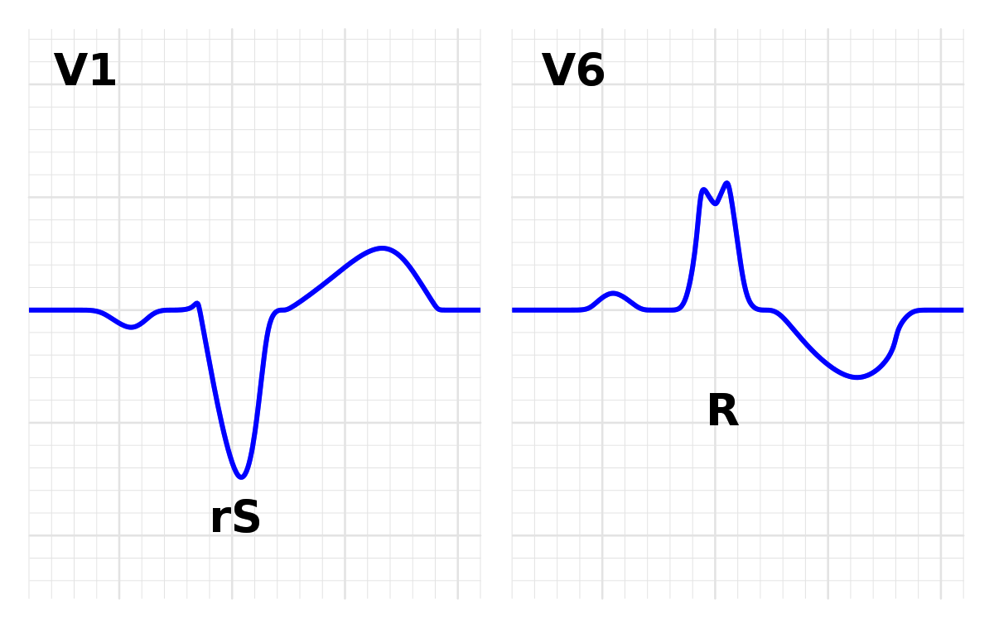
BBBs:
complete/incomplete- RBBB/LBBB
normal variants in some individuals
age-related fibrosis in the conduction system
LBBB:
structural heart disease:
hypertensive heart disease
IHD
cardiomyopathies
valvular heart disease

Slide 13
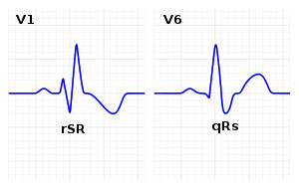
RBBB:
⬆︎ right ventricular pressures:
pulmonary hypertension
cor-pulmonale
pulmonary embolism
prior radiation exposure
myocarditis
structural heart disease:
IHD
cardiomyopathies
valvular heart disease
congenital heart disease
The presence of a BBB is not itself an indicator of increased perioperative cardiovas- cular risk.

Slide 14
Recent onset/new diagnosis of BBB → more extensive evaluation for undiagnosed cardiovascular disease:
LBBB: ⬆︎ risks of (in the nonoperative setting):
incident cardiovascular disease
cardiovascular mortality
mortality
RBBB: ⬆︎ risks of mortality in:
suspected IHD
known IHD
heart failure
No significant pulmonary disease, IHD, structural heart disease, or Brugada syndrome→ no further preoperative evaluation
known/suspected pulmonary disease (pulmonary hypertension) → severe respiratory or vascular compromise ⇒ pulmonary evaluation/echocardiography in intermediate/high-risk surgery

Slide 15
Atrial Fibrillation

Slide 16
variable irregular ventricular response + absence of regular/organized atrial activity
paroxysmal: terminates spontaneously/with intervention within 7 days of onset
persistent: fails to self-terminate within 7 days
long-standing persistent: lasts more than 12 months
permanent persistent: a joint decision- patient and clinician- no longer pursue a rhythm control strategy

Slide 17
etiology
No structural heart disease (previously “lone atrial fibrillation”)
underlying disorders
high-income countries
hypertension
ischemic heart disease
Others
valvular heart disease
heart failure
hypertrophic cardiomyopathy
congenital heart disease
obesity
diabetes mellitus
CKD
increased age
low/middle-income countries
rheumatic heart disease
Potentially reversible acute triggers
hyperthyroidism
recent surgery (especially cardiac/thoracic surgery)

Slide 18
⬆︎ risk for:
death
heart failure
thromboembolic events (stroke)
hospitalization
In nonoperative setting:
ventricular rate control
restore sinus rhythm
prevention of systemic embolization
Strategies that focused on heart rate control versus rhythm control → similar effects (stroke/death)

Slide 19
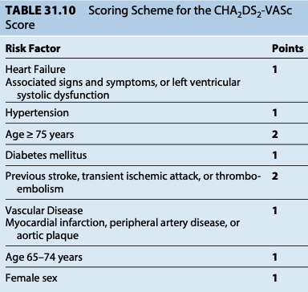
The CHA2DS2- VASc score → long- term systematic embolization risk:
low-risk (0 points: 0.2% annualized stroke rate)
intermediate-risk (1 point: 0.6% annualized stroke rate)
high- risk (≥2 points: >2.2% annualized stroke rate)

Slide 20
ACC/ AHA guidelines:
long-term oral anticoagulation:
nonvalvular atrial fibrillation
CHA2DS2-VASc scores ≧2
omitting anticoagulation in CHA2DS2-VASc scores = zero
Best treatment for CHA2DS2-VASc scores of 1???
ACC/AHA guidelines→ all reasonable approaches:
oral anticoagulant therapy
aspirin therapy
omitting anticoagulation
For nonvalvular AF:
vitamin K antagonist (warfarin)
DOAC (dabigatran, rivaroxaban, edoxaban, apixaban)

Slide 21
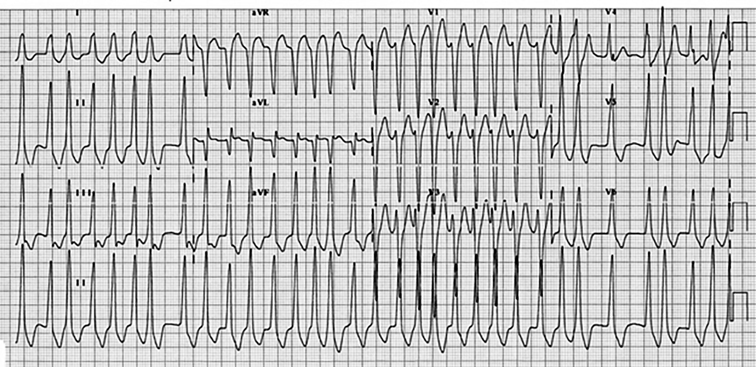
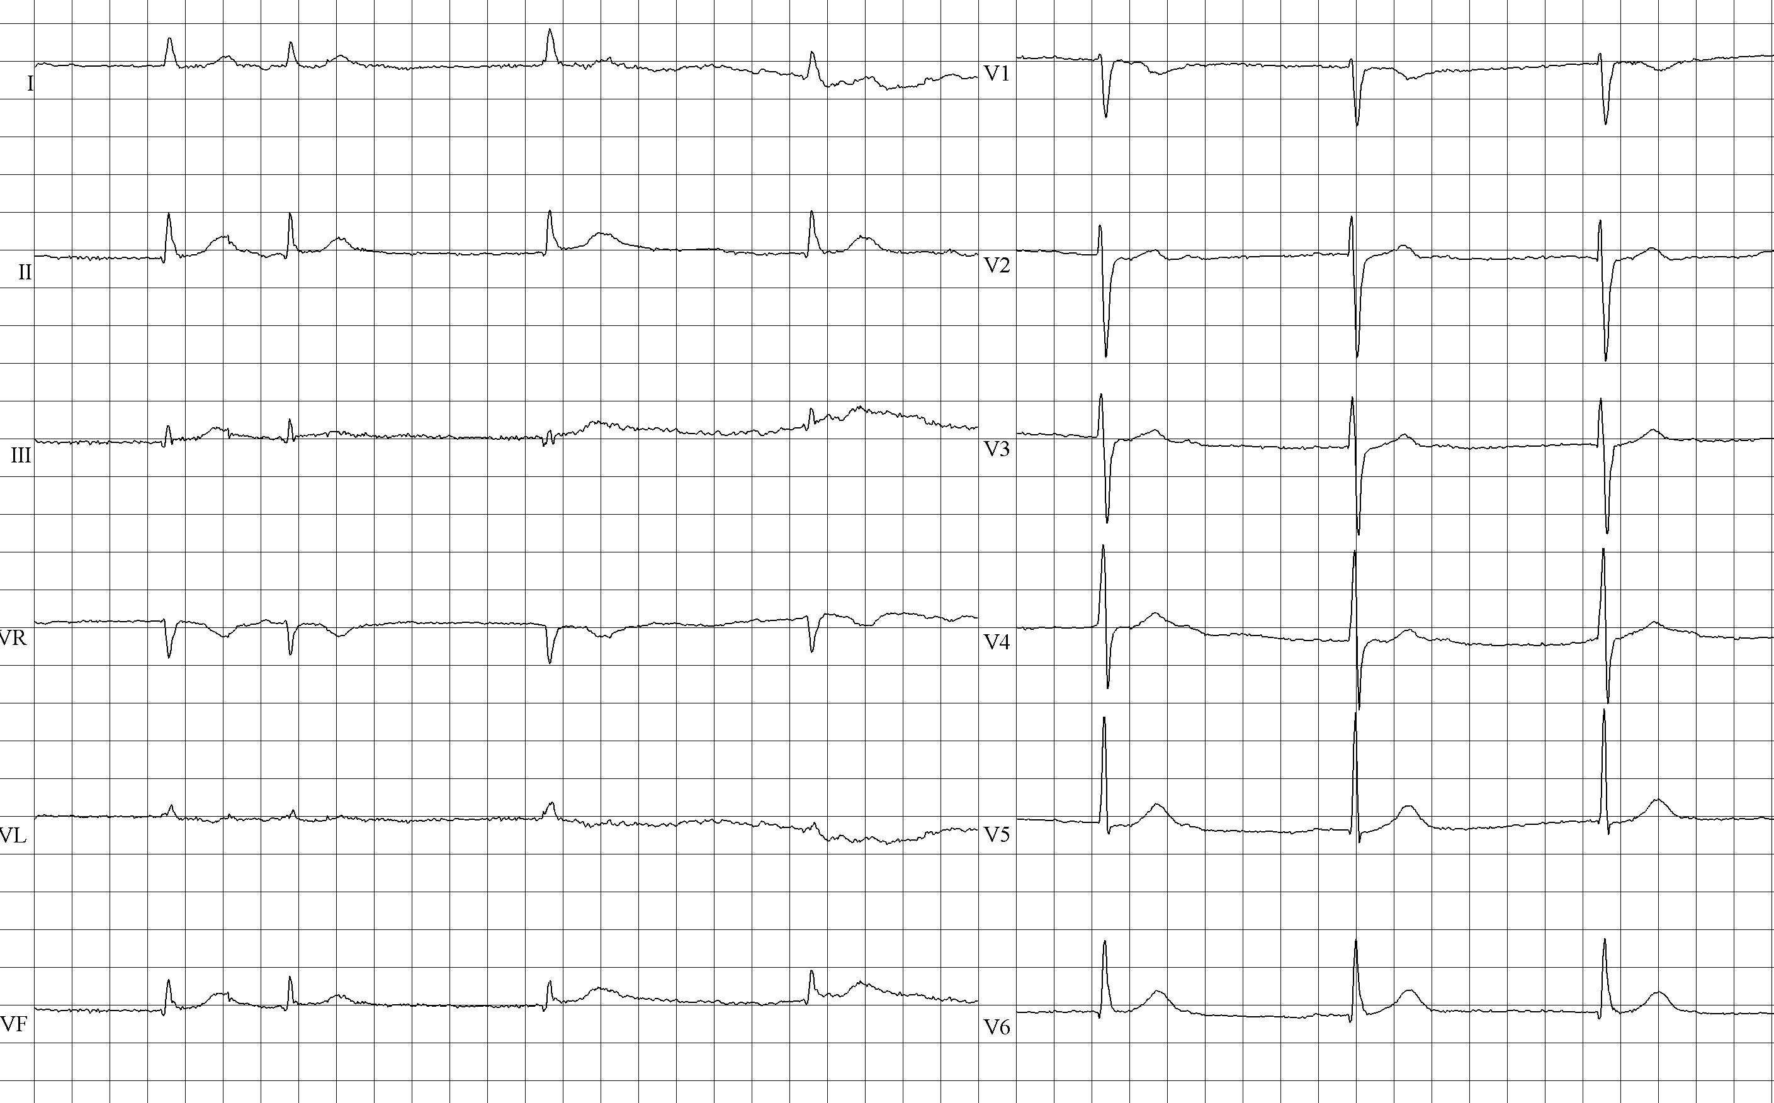
The preoperative evaluation:
underlying conditions (ischemic heart disease)
complications (heart failure, stroke)
rate/rhythm control strategies
anticoagulation strategies
rapid ventricular rates → rate control
AF + slow ventricular rate without rate-controlling medications → sick sinus syndrome→ previous episodes of syncope/presyncope?
long-term β-adrenergic blockers, digoxin, calcium channel blockers, or antiarrhythmic medications should be continued.

Slide 22
The critical component for preoperative planning → management of long-term anticoagulants- ideally + treating physician + surgeon
whether temporary preoperative discontinuation is needed
when oral anticoagulants should be discontinued
whether bridging therapy with LMWH is required
Continue vitamin K antagonist therapy if:
No patient-related risk factors for bleeding
Procedures without important bleeding risk (dental extraction, simple cutaneous procedures, pacemaker insertion)

Slide 23
Otherwise → temporarily discontinue anticoagulant medications before surgery
vitamin K antagonists → stopped 5 days before surgery
longer discontinuation period for initial INR > 3.0
INR should be rechecked within 24 hours before surgery + low dose oral vitamin K for any INR > 1.5
Timing of preoperative discontinuation of DOACs:
specific drug
procedural bleeding risk
renal function
planned use of neuraxial anesthesia

Slide 24
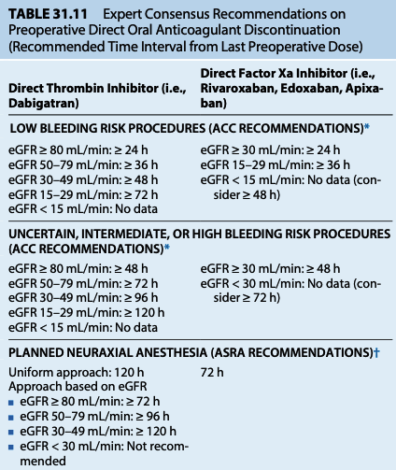
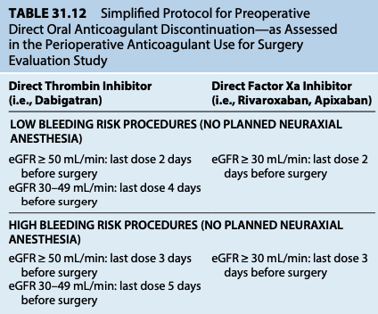

Slide 25
Nonvalvular AF → no bridging therapy if anticoagulant therapy is temporarily discontinued before surgery
Bridging therapy → ⬆︎ risks of major bleeding:
DOACs: not needed
vitamin K antagonist therapy:
low-risk patients
CHA2DS2-VASc scores ≦ 4
no prior stroke, TIA, systemic embolization
omit bridging therapy
high-risk patients
CHA2DS2-VASc scores ≧ 7
recent (prior 3 months) stroke, TIA, systemic embolization
bridging therapy
intermediate-risk patients
no significant bleeding risk
> 3 months of stroke, TIA, systemic embolization
bridging therapy

Slide 26
Supraventricular Arrhythmias

Slide 27
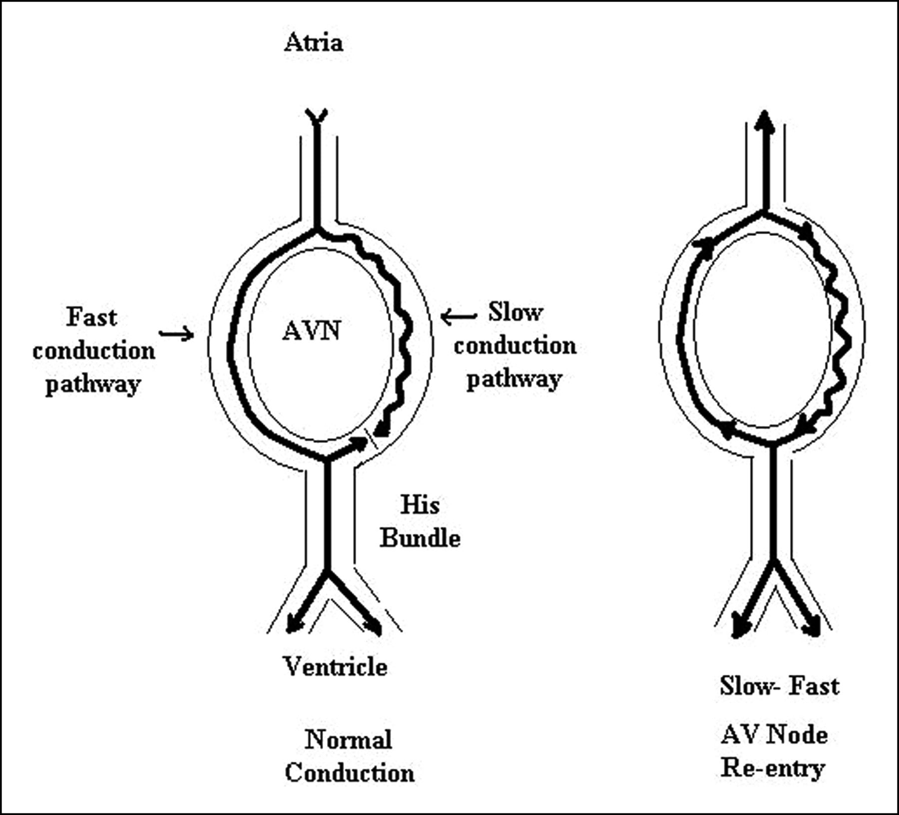
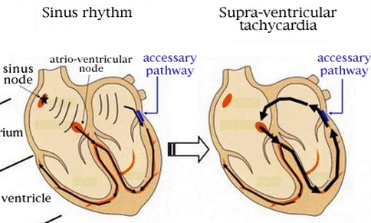
ectopic atrial foci + rapid conduction through the AV node
reentry mechanism
AV node-Purkinje system
accessory reentry pathway
adenosine, verapamil, β-blockers
WPW syndrome → bundle of Kent

Slide 28
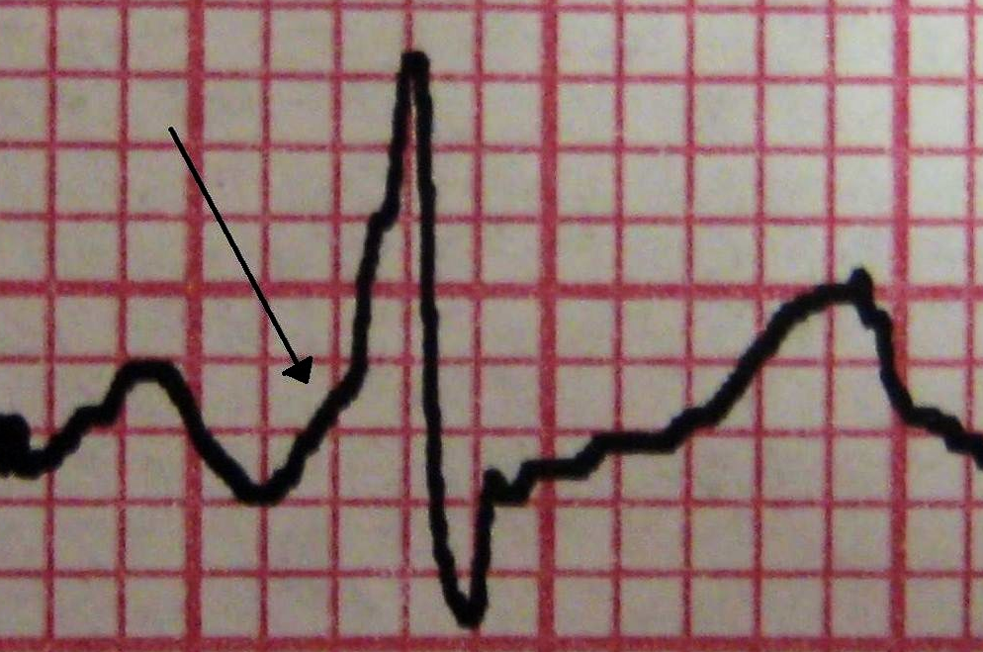
bundle of Kent
retrograde conduction
antegrade conduction
short PR interval (<0.12 ms)
delta wave
supraventricular tachycardia
treatment of SVT in WPW with AV nodal blocking drugs → ⬆︎ conduction over the accessory pathway ⇒ ventricular fibrillation
acute SVT:
electrical cardioversion
ibutilide
procainamide
long-term management:
catheter ablation

Slide 29
Ventricular Arrhythmias

Slide 30
wide QRS complex (>0.12 ms)
absence of an associated P-wave
Benign ventricular arrhythmias:
isolated ventricular premature beats (VPBs)
no associated heart disease
no increased risk of sudden cardiac death
do not need further cardiology evaluation

Slide 31
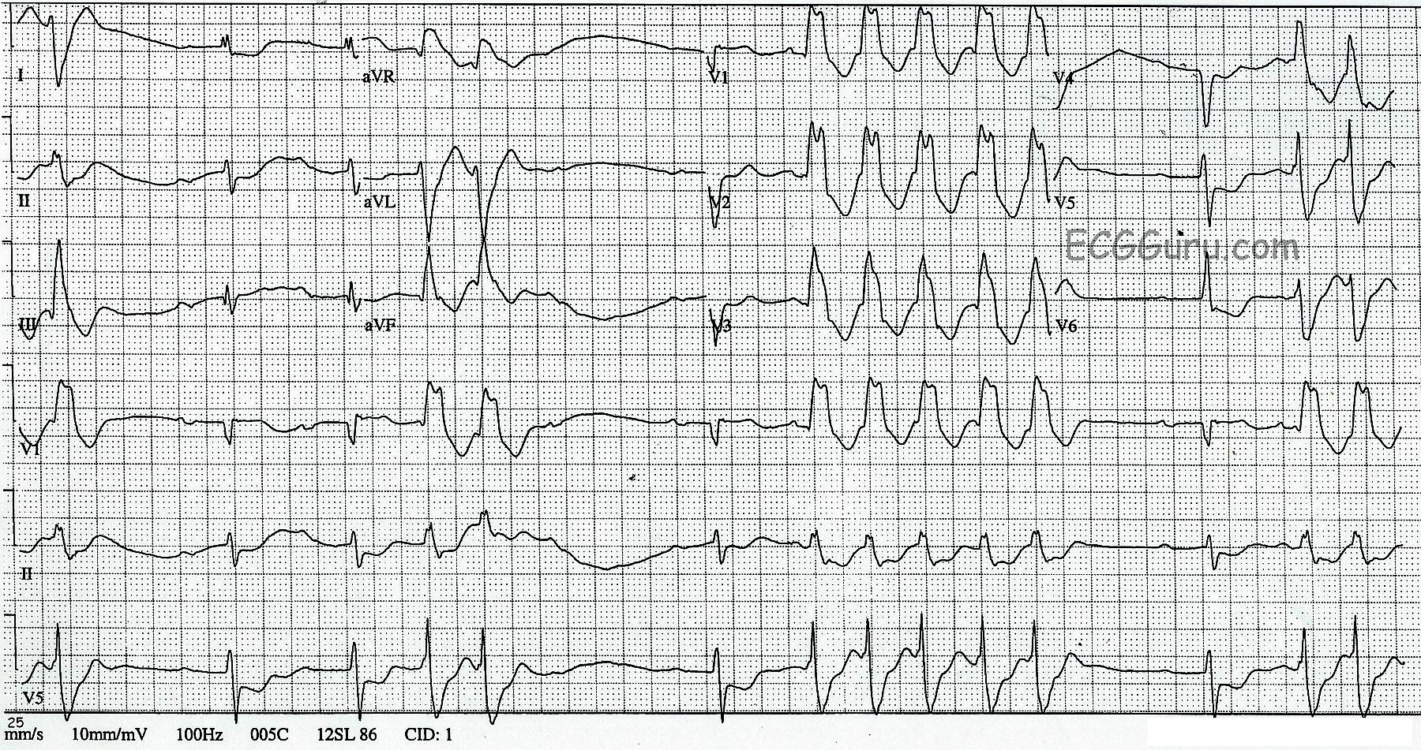
Potentially lethal arrhythmias:
> 30 VPBs/hour
non-sustained VT + underlying heart disease
moderately high risk of sudden cardiac arrest → ICD
cardiology evaluation/echocardiography
cardiac stress testing, coronary angiography, electrophysiology testing

Slide 32
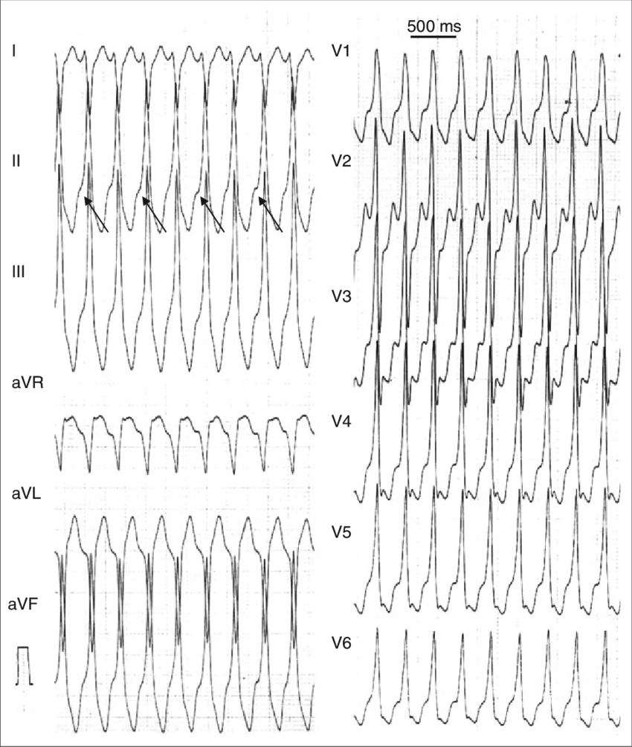
Lethal arrhythmias:
sustained VT
VF
VPBs associated with:
underlying heart disease
depressed cardiac function
hemodynamic compromise
high risk for sudden cardiac arrest →
ICD
cardiology evaluation
echocardiography, cardiac stress testing, coronary angiography, electrophysiology testing

Slide 33
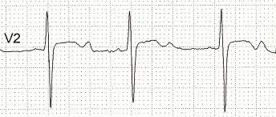
Reversible causes of ventricular arrhythmias (hypokalemia, ischemia, acidosis, hypomagnesemia, drug toxicity, endocrine dysfunction) should be sought out and treated.
Any long-term anti-arrhythmic medications should be continued perioperatively.
hypokalemia-induced triggered arrhythmias:
Torsades De Pointes
polymorphic VT
ventricular fibrillation (VF)
ventricular ectopy
This part is not in the book.

Slide 34
Long QT Syndrome

Slide 35
LQTS → myocardial repolarization disorder associated with a prolonged QT interval
leads II and V5- from the onset of the QRS complex to the end of the T wave
interval varies inversely with heart rate⇒
prolonged QTc:
exceeding the 99th percentile
> 0.48 s in women, > 0.47 s in men
predisposed to → torsades de pointes (polymorphic VT + frequent variations of the QRS axis/morphology)

Slide 36
antiarrhythmic drugs (quinidine, sotalol, dofetilide, ibutilide)
psychotropic medications (haloperidol, methadone)
erythromycin
cisapride
metabolic abnormalities (⬇︎K, ⬇︎Mg, ⬇︎Ca)
acquired
LQTS
ICD implantation
correction of underlying metabolic disorders
congenital (genetic)
β-blockers
Amiodarone does markedly prolong the QT interval, it is rarely associated with torsades de pointes except in association with hypokalemia.

Slide 37
Brugada Syndrome

Slide 38
Rare cause of sudden cardiac arrest
No structural heart disease
Autosomal dominant
Men > women
Rarely diagnosed in children
Asian ethnicity
echocardiography, stress testing, cardiac MRI → normal
clinical manifestations:
ventricular arrhythmias
syncope
sudden death
⬆︎ risk of atrial arrhythmias, especially AF

Slide 39
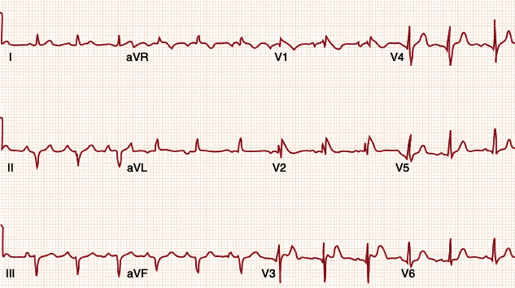
ECG:
pseudo-RBBB
persistent ST-segment elevation in leads V1 to V3
In some cases, these changes are transient - provoked by medications

Slide 40
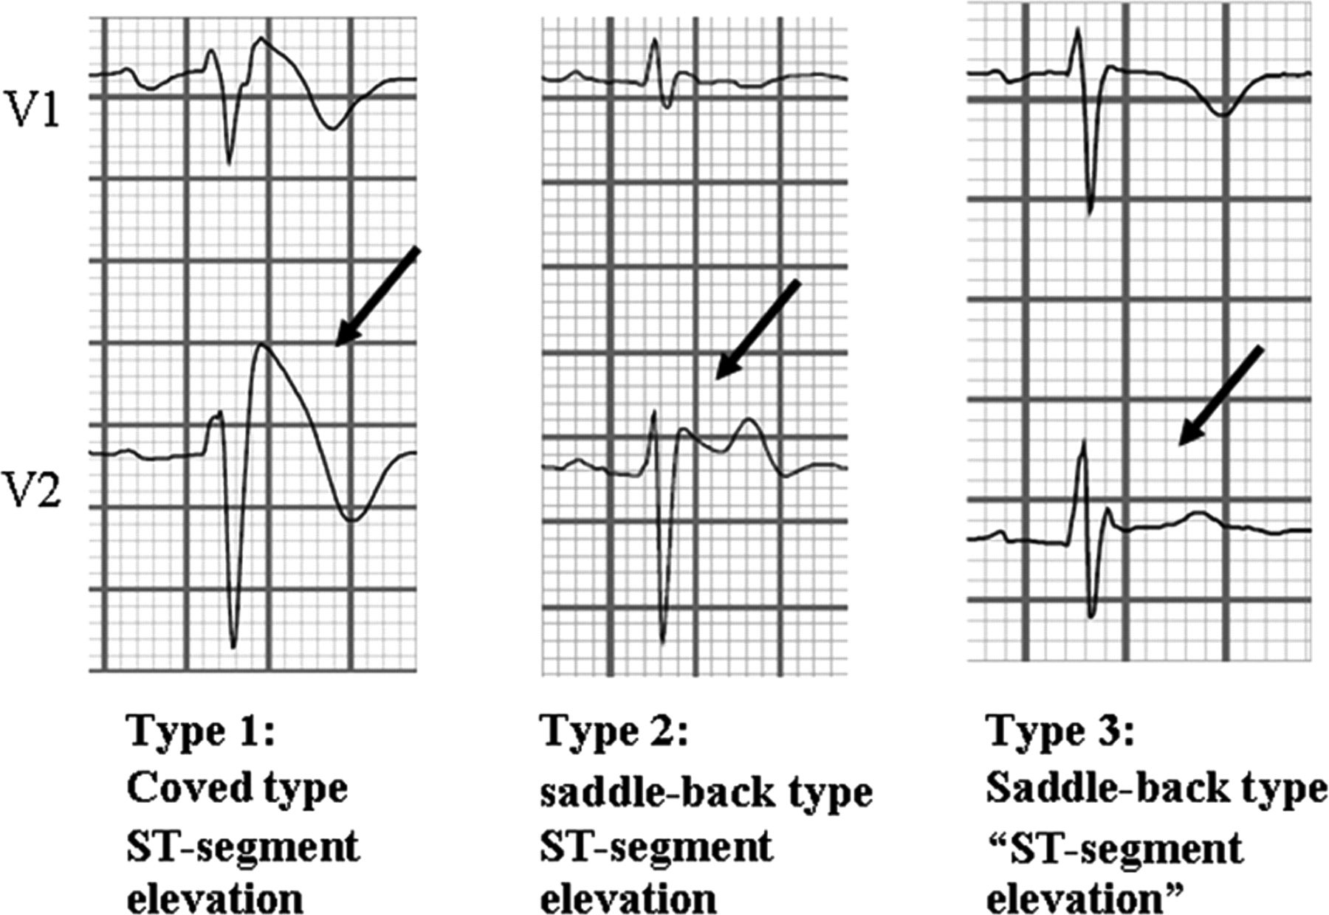
This part is not in the book.

Slide 41
Asymptomatic patients + typical ECG features → “Brugada pattern.”
Drugs that are associated with adverse events:
propofol
bupivacaine
class I antiarrhythmic drugs (flecainide, procainamide)
β-blockers
ICD implantation is the standard of care for Brugada syndrome.

Slide 42
A short video about Reentry Mechanism…

Slide 43
This part is not in the book.

